Slide 1
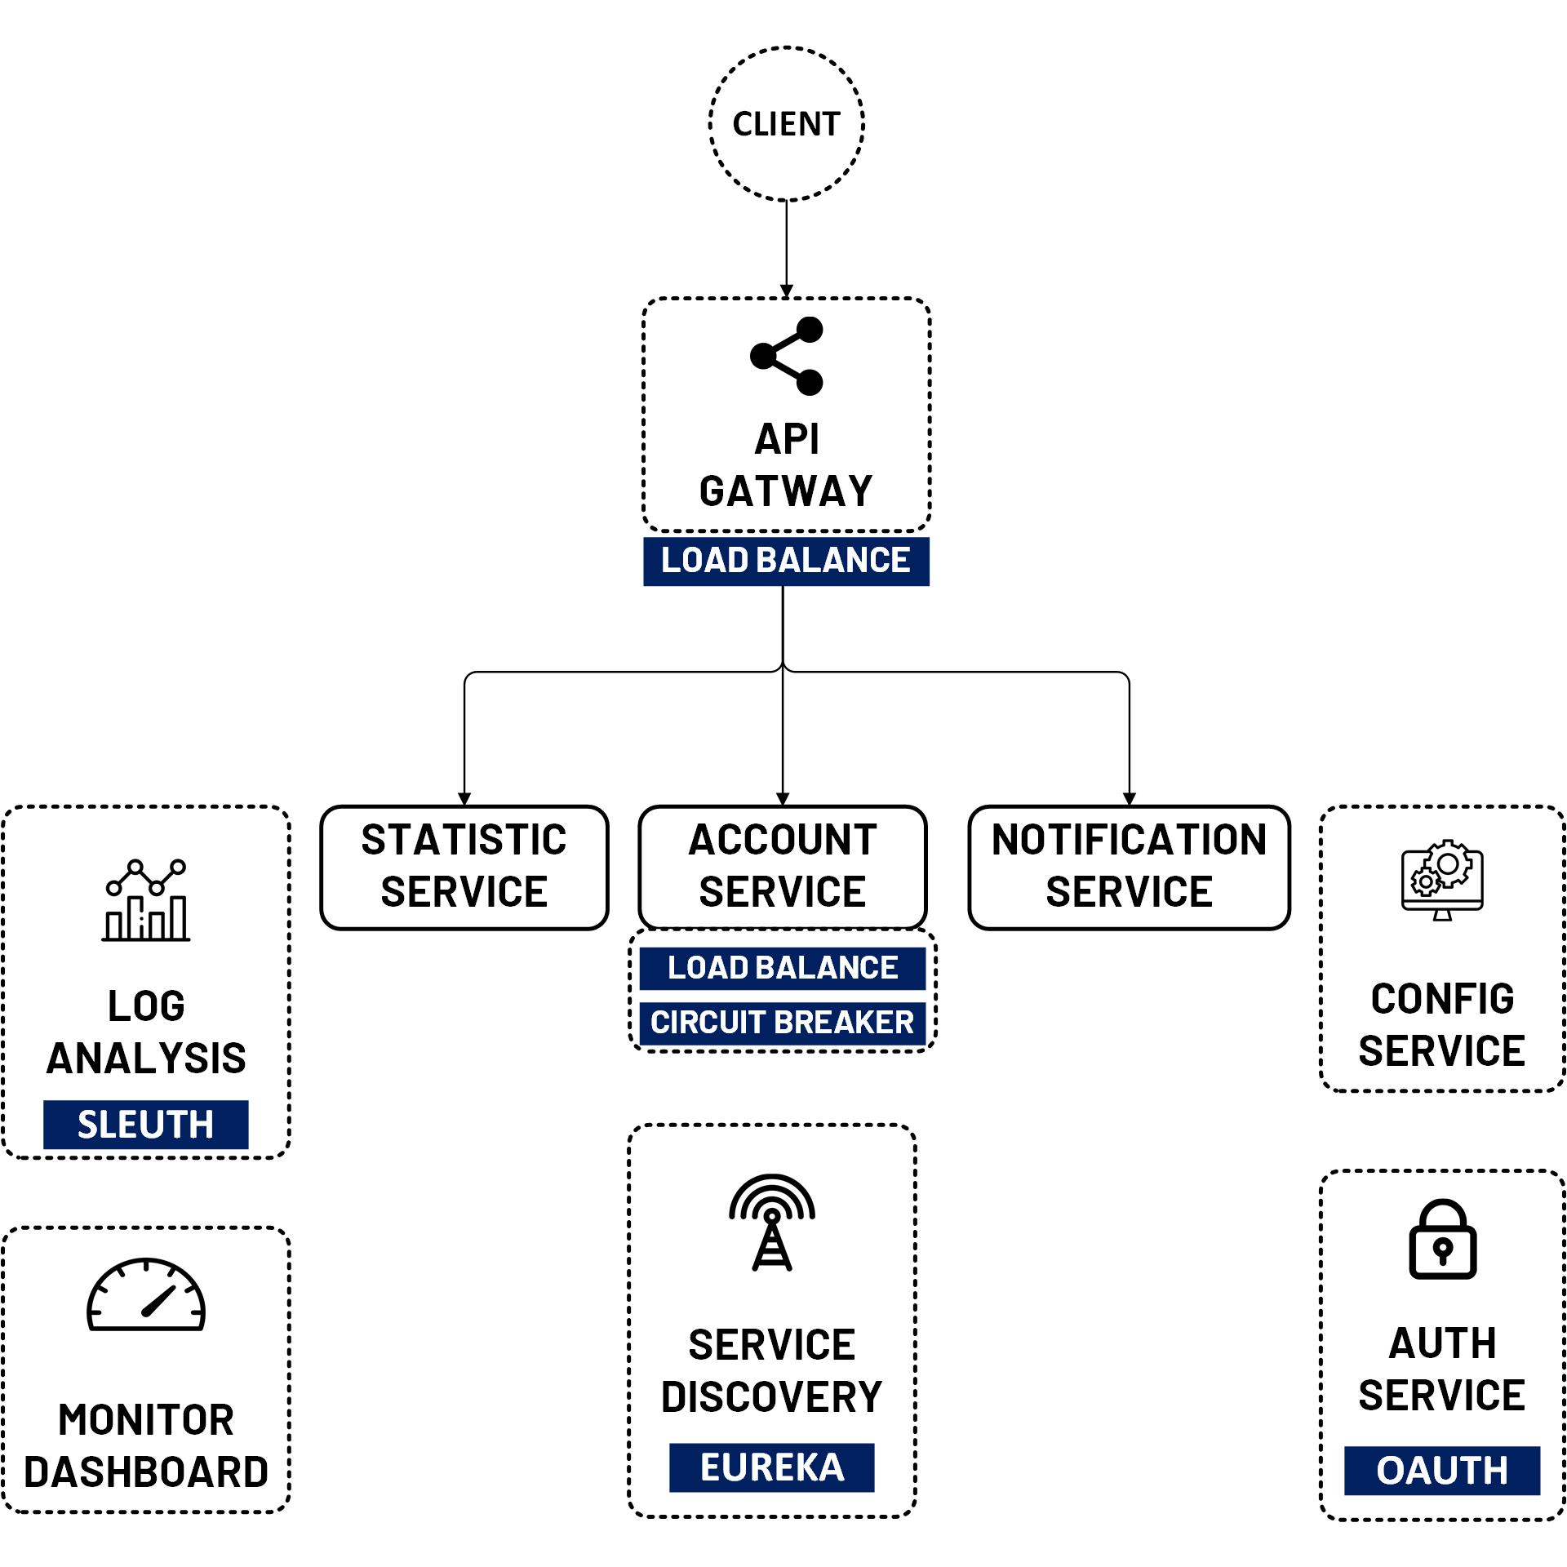

OAuth 2 Security Authorization Code (Spring Security OAuth2)
www.jmaster.io/course/microservices-with-spring-cloud

